Slide 1
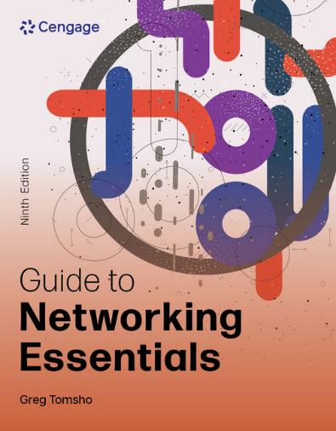
Guide to Networking Essentials, 9e
Chapter 8: Network Hardware in Depth
.

Slide 2
Chapter Objectives
By the end of this chapter, you should be able to:
Describe the advanced features and operation of network switches
Describe routing table properties and discuss routing protocols
Use the Cisco command line interface
Explain basic and advanced wireless access point features
Select the most suitable NIC bus and features for a computer

Slide 3
Network Switches in Depth (1 of 2)
Switches work at the Data Link layer (Layer 2) of the OSI model
Switches receive frames on one port and forward them out the port where the destination device can be found
Switches flood broadcast frames out all ports
Each switch port is considered a collision domain
Switches do not forward collision information to any other ports
Switch ports can operate in full-duplex mode
Allows connected devices to transmit and receive simultaneously, eliminating the possibility of a collision

Slide 4
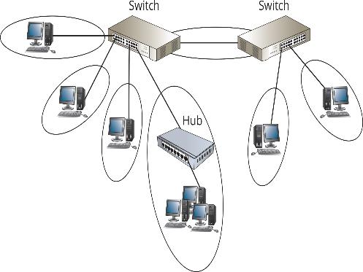
Network Switches in Depth (2 of 2)
Figure 8-1 Each switch connection is a collision domain

Slide 5
Switch Port Modes of Operation (1 of 2)
Ports on a typical 10/100 Mbps switch can usually operate in these modes:
10 Mbps half-duplex
100 Mbps half-duplex
10 Mbps full-duplex
100 Mbps full-duplex
1000 Mbps full-duplex

Slide 6
Switch Port Modes of Operation (2 of 2)
Most switches run in auto-negotiate mode
This means the switch exchanges information with a device connected to a port and attempts to set the port’s operating mode to the highest performance setting supported
Auto-MDIX (media-dependent interface crossed) is an option in which the switch port detects the type of device/cable it is connected to
Enables you to use a straight-through or crossover cable
A managed switch allows an administrator to configure a variety of operating and security options on the switch

Slide 7
Creating the Switching Table (1 of 3)
A switching table holds MAC address/port pairs that tell the switch where to forward a frame, based on the destination MAC address
When a switch is first powered on, its table is empty
As network devices send frames, the switch reads each frame’s source address and adds it to the table along with the port it was received from
If a frame’s destination address isn’t found in the switching table the switch forwards the frame out all ports

Slide 8
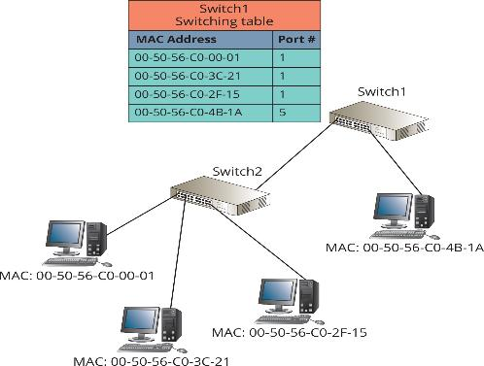
Creating the Switching Table (2 of 3)
Figure 8-2 Switching tables can contain multiple MAC addresses per port

Slide 9
Creating the Switching Table (3 of 3)
Most switches include a number that indicates the number of MAC addresses the switch can hold
Switching tables prevent stale entries by including a timestamp when an entry is created
When a switch receives a frame from a device already in its table, it updates the entry with a new timestamp
The period of time a table keeps a MAC address is called the aging time
If the timestamp isn’t updated within the aging time, the entry expires and is removed from the table

Slide 10
Frame Forwarding Methods
Cut-through switching is the fastest method in which the switch reads only enough of the incoming frame to determine the frame’s source and destination addresses
Disadvantage: the switch might forward frames containing errors
Store-and-forward switching requires that the switch read the entire frame into its buffers before forwarding it
Disadvantage: this process takes time and slows the network slightly
Fragment-free switching is a method in which the switch reads enough of the frame to guarantee that it’s at least the minimum size for the network type

Slide 11
Advanced Switch Features (1 of 11)
High-end switches (referred to as “smart switches” or “managed switches) can help make a network more efficient and reliable
The following are the most common features found in managed switches:
Multicast processing
Spanning Tree Protocol
Virtual local area networks
Port security
Port Aggregation

Slide 12
Advanced Switch Features (2 of 11)
Multicast Processing
Switches process multicast frames in one of two ways:
As broadcasts and sends them out all ports
By forwarding the frames only to ports that have registered the multicast address
Used by switches that support Internet Group Management Protocol (IGMP)
Multicast MAC addresses always begin with 01:00:5E
The rest of the address identifies a particular multicast application

Slide 13
Advanced Switch Features (3 of 11)
Spanning Tree Protocol
A switching loop occurs when switches are connected in such a way that it’s possible for frames to be forwarded endlessly from switch to switch in an infinite loop
If this type of loop occurs with a broadcast frame, it’s referred to as a broadcast storm
Spanning Tree Protocol (STP) enables switches to detect when there is a potential for a switching loop

Slide 14
Advanced Switch Features (4 of 11)
Spanning Tree Protocol (continued)
When a possible loop is detected:
One of the switch ports goes into blocking mode, preventing it from forwarding frames that would create a loop
If the loop configuration is broken, the switch that was in blocking mode resumes forwarding frames
Rapid Spanning Tree Protocol (RSTP) is an enhancement to STP that provides faster convergence when the topology changes

Slide 15
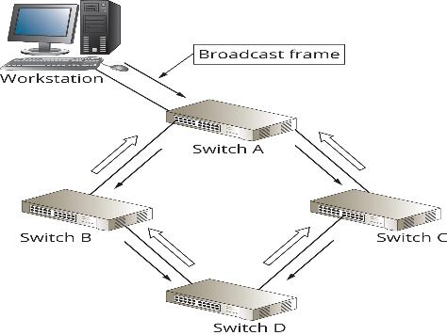
Advanced Switch Features (5 of 11)
Figure 8-3 Switches with redundant paths can create a switching loop

Slide 16
Advanced Switch Features (6 of 11)
Virtual Local Area Networks
Virtual local area networks (VLANS) enable you to configure one or more switch ports into separate broadcast domains
It’s like separating a switch into two or more switches that aren’t connected to one another
A router is needed to communicate between VLANs
A switch with VLAN capability improves management and security of the network and gives more control of broadcast frames
VLANs allow administrators to group users and resources logically instead of by physical location

Slide 17
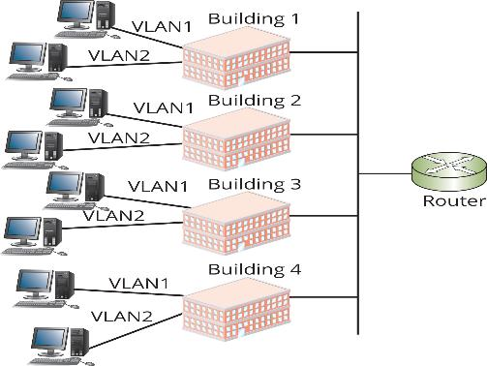
Advanced Switch Features (7 of 11)
Figure 8-5 VLANs logically group users and resources from different physical locations

Slide 18
Advanced Switch Features (8 of 11)
VLAN Trunks
A trunk port is a switch port configured to carry traffic from all VLANs to another switch or router
The switch or router port must also be configured as a trunk port
IEEE 802.1Q defines how to configure a trunk port, which involves the switch adding a tag to each frame that must traverse the trunk port
The VLAN tag identifies which VLAN the traffic originated from

Slide 19
Advanced Switch Features (9 of 11)
Factors to Consider Before Using VLANs:
Overuse of VLANs can cost more than it benefits you
More VLANs mean more logical networks so your network will be more complicated
Every VLAN you create requires a corresponding router interface
Routers are slower devices, so performance can decrease with the addition of more VLANs
More router interfaces mean additional IP networks, which is likely to require subnetting your existing network

Slide 20
Advanced Switch Features (10 of 11)
Switch Port Security
In some public buildings, connections are often available to public users, who can use devices that contain viruses, hacker tools, and other malware
A switch with port security features can help prevent this type of connection
Port security on most switches enables an administrator to limit how many and which MAC addresses can connect to a port
If an unauthorized computer attempts to connect, the port can be disabled and a message can be sent to the administrator to alert them of the intrusion

Slide 21
Advanced Switch Features (11 of 11)
Port aggregation is a feature available on some switches that allows you to bind multiple switch ports together to act as a single switch port
It increases the bandwidth of the link between two devices
Devices on both sides of the link must support port aggregation
On Windows, this feature is called NIC teaming
The most common protocol is link aggregation control protocol (LACP)

Slide 22
Types of Switch Ports
Part 2
Enterprise level switches can have the following types of ports:
RJ-45 Ethernet port
RJ-45 Ethernet port with Power over Ethernet (PoE)—supplies power to a variety of devices
Fiber optic Ethernet port
Small Form-Factor Pluggable (SFP) slots—a small pluggable network interface module
Cisco devices have a console port, which is used for configuration

Slide 23
Multilayer Switches
Some advanced devices have all the functions of a managed switch (Layer 2) but add Layer 3 capabilities
Multilayer switches are typically used in the interior of networks to route between VLANs instead of being placed on the network perimeter
These switches offer a performance advantage over traditional routers
Packet routing between VLANs is done within the switch instead of having to exit the switch to a router

Slide 24
Routers in Depth (1 of 2)
Routers operate at the Network layer (Layer 3) and work with packets
Broadcast frames are not forwarded to other router ports
Routers can be used to create complex internetworks with multiple paths creating fault tolerance and load sharing
The processing done by routers depends on the following features found on most routers:
Router interfaces, routing tables, routing protocols, and access control lists (ACLs)

Slide 25
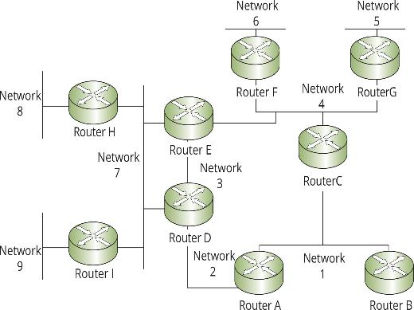
Routers in Depth (2 of 2)
Figure 8-8 Routers can connect networks with many different paths between them

Slide 26
Router Interfaces (1 of 2)
Routers must have two or more interfaces (ports) in order to forward packets to other networks
When a router interface receives a frame, it compares the destination MAC address with the interface’s MAC address
If they match, the router strips the frame header and trailer and reads the packet’s destination IP address
If the IP address matches it processes the packet
If the IP address does not match, the router consults its routing table to determine how to get the packet to its destination
This process is called packet forwarding

Slide 27
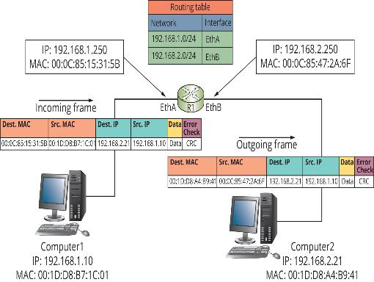
Router Interfaces (2 of 2)
Figure 8-9 Packets are forwarded from one network to another

Slide 28
Routing Tables (1 of 3)
Routing tables are composed of network address and interface pairs that tell the router which interface a packet should be forwarded to
Most routing tables contain the following for each entry:
Destination network
Next hop—indicates an interface name or the address of the next router in the path to the destination (total number of routers a packet must travel through is called the hop count)
Metric—a numeric value that tells the router how “far away” the destination network is (also called cost or distance)

Slide 29
Routing Tables (2 of 3)
Most routing tables contain the following for each entry (continued):
How the route is derived—this field tells you how the route gets into the routing table (one of 3 ways):
The destination network is connected directly to one of the router’s network interfaces (referred to as a directly connected route)
An administrator enters the route information manually (called a static route)
Route information is entered dynamically, via a routing protocol
Timestamp—tells the router how long it has been since the routing protocol updated the dynamic route

Slide 30
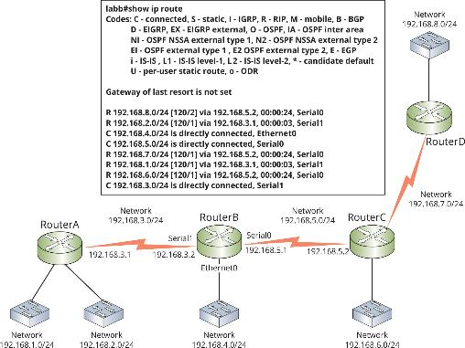
Routing Tables (3 of 3)
Figure 8-10 An internetwork and a router’s routing table

Slide 31
Routing Protocols (1 of 4)
A routing protocol is a set of rules that routers use to exchange information so that all routers have accurate information to populate their routing tables
There are two main types of routing protocols:
Distance-vector protocols share information about an internetwork’s status by copying a router’s routing table to other routers (neighbors)
Routing Information Protocol (RIP) and RIPv2 are most common
Link-state protocols share information with other routers by sending the status of all their interface links to other routers
Open Shortest Path First (OSPF) is most common

Slide 32
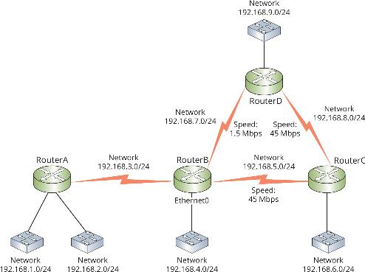
Routing Protocols (2 of 4)
Figure 8-11 When using RIP, a router always chooses the path with the lower hop count

Slide 33
Routing Protocols (3 of 4)
Interior gateway protocols (IGP) are used in an autonomous system (AS)
An AS is an internetwork managed by a single organization
Exterior gateway protocols (EGP) are used between autonomous systems
Example of EGP is Border Gateway Protocol (BGP)
BGP is a path-vector routing protocol, which analyzes characteristics of all autonomous systems to form a nonlooping routing topology
A border router connects one autonomous system to another

Slide 34
Routing Protocols (4 of 4)
Static routes can be entered in a routing table manually
Consider the following before deciding:
Does the network change often? If so, a routing protocol is probably a good choice
Are there several alternate paths to many of the networks in the internetwork? If so, a routing protocol can reroute around down links or congested routes automatically
Is the internetwork large? A routing protocol builds and maintains routing tables automatically

Slide 35
Access Control Lists
An access control list (ACL) is a set of rules configured on a router’s interface for specifying which addresses and which protocols can pass through an interface and to which destinations
When an ACL blocks a packet it is called packet filtering
ACLs are usually configured to block traffic based on the following:
Inbound or outbound traffic, source address, destination address, protocol
Addresses can be specific IP addresses or network numbers and filtering can be done on either source or destination address or both

Slide 36
Knowledge Check Activity 8-1
Which switching method prevents a switch from forwarding frames that are less than 64 bytes on an Ethernet network but allows the switch to forward frames that contain other errors?
a. Cut-through
b. Fast-forward
c. Fragment-free
d. Store-and-forward

Slide 37
Knowledge Check Activity 8-1: Answer
Which switching method prevents a switch from forwarding frames that are less than 64 bytes on an Ethernet network but allows the switch to forward frames that contain other errors?
Answer: c. Fragment-free
Explanation: One switching method is fragment-free switching, in which the switch reads enough of the frame to guarantee that it’s at least the minimum size for the network type. For Ethernet, it’s 64 bytes.

Slide 38
Using the Cisco Command Line Interface (1 of 2)
You connect to a Cisco device by connecting a serial port on your computer to the console port on the device using a rollover cable
You can use a USB to serial adapter
Common commands include the following:
show version
show mac address-table
show interfaces and show ip interface brief
show running-config
configure terminal

Slide 39
Using the Cisco Command Line Interface (2 of 2)
If you want to use commands that view the configuration file or alter the operation of the device, you need to be in privileged EXEC mode
To do so, you type enable and press enter
The # at the end of the prompt means you are in privileged EXEC mode
After you enter configure terminal, you are in global configuration mode, where you can enter commands that affect the device
The prompt will include (config)#

Slide 40
Wireless Access Points in Depth
This section discusses some configuration options on most wireless APs and wireless routers
A wireless router is actually three devices in one:
A wireless AP
A router
A switch

Slide 41
Basic Wireless Settings
Basic wireless settings on most APs:
Wireless network mode allows you to choose which 802.11 standard the AP should operate under
Wireless network name (SSID)—when an AP is shipped the SSID is set to a default value,, and it is recommended that you change it upon setup
Wireless channel—it is recommended that you set your channels five channels apart, such as 1, 6, and 11
SSID broadcast status—by default, APs are configured to transmit the SSID so that any wireless device in range can see the network
To enable/disable the SSID broadcast is a low-end security option

Slide 42
Wireless Security Options
Most APs offer the following security options:
Encryption
Authentication
MAC filtering
AP isolation
Use the highest level of security your systems support (all devices must use the same protocol)
MAC address filtering enables you to restrict which devices connect to your AP

Slide 43
Advanced Wireless Settings
Common advanced settings:
Adjustable transmit power
Multiple SSIDs
VLAN support
Traffic priority
Wi-Fi Multimedia
AP modes
Target Wake Time (TWT)
Orthogonal frequency-division multiple-access (OFDMA)

Slide 44
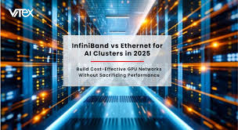
Network Interface Cards in Depth
A NIC makes the connection between a computer and the network medium
Performance and reliability of the NIC are crucial to the computer’s network performance
Yout-ube.com/watch?v=fb69FyW2KLk

Slide 45
PC Bus Options (1 of 2)
A bus makes the connections between a computer’s vital components
The faster the bus, the faster data can be transferred between these components, which makes for a faster system
NICs are considered I/O devices and can be built into the motherboard or added as an expansion card

Slide 46
PC Bus Options (2 of 2)
Table 8-3 Common bus types
Bus type | Maximum transfer rate | Bus size | Use
PCI | 533 MBps | 32 and 64 bits | Declining; absent on most server
PCI-X | 4 GBps | 32 and 64 bits | Declining use on servers and high-end workstations
PCI Express (PCIe) | 32 GBps | 1 and 32 serial lanes | Standard on all types of computers
USB 3.0 USB 3.1 USB 3.2 | 625 MBps 1.25 GBps 2.5 GBps | N/A | Laptops and easy addition of NICs to desktops

Slide 47
Advanced Features of NICs (1 of 3)
When selecting a network adapter, first identify the physical characteristics the card must match
Type of bus, type of network technology, kind of connector needed to connect to media
Hardware-enhancement options include the following:
Shared adapter memory—the adapter’s buffers map directly to RAM on the computer
Shared system memory—a NIC’s onboard processor selects a region of RAM on the computer and writes to it as though it were buffer space on the adapter

Slide 48
Advanced Features of NICs (2 of 3)
Hardware-enhancement options include the following (continued):
Bus mastering—permits a network adapter to take control of the computer’s bus to initiate and manage data transfers to/from the computer’s memory
RAM buffering—a NIC includes additional memory to provide temporary storage for incoming and outgoing network data that arrives at the NIC faster than it can be sent out
Onboard co-processors—enable the card to process incoming and outgoing network data without requiring service from the CPU
https://www.yout-ube.com/watch?v=3-KakmVmEpo
Basic Network Device Commands

Slide 49
Advanced Features of NICs (3 of 3)
Hardware-enhancement options include the following (continued):
Automatic link aggregation enables you to install multiple NICs in one computer and aggregate the bandwidth
Improved fault tolerance by installing a second NIC
Advanced Configuration Power Management Interface (ACPI) offers Wake-on-LAN (WoL), which allows an administrator to power on a PC remotely by accessing the NIC through the network
Preboot Execution Environment (PXE)-compliant adapters allow a computer to download an OS instead of booting it from a local hard drive

Slide 50
Knowledge Check Activity 8-2
Which character is found at the end of the Cisco IOS prompt when the user is in privileged EXEC mode?
a. $
b. #
c. >
d. %

Slide 51
Knowledge Check Activity 8-2: Answer
Which character is found at the end of the Cisco IOS prompt when the user is in privileged EXEC mode?
Answer: b. #
Explanation: If you want to use commands that view the configuration file or alter the operation of the device, you need to switch to privileged EXEC mode; to do so you type enable and press Enter. The prompt now looks like this: Switch#. The # at the end of the prompt signifies that you are in privileged EXEC mode.
Notes:
https://www.pfsense.org/download/

Slide 52
Self Assessment
Compare the three different frame forwarding methods discussed in this chapter. Which method does not forward error frames? What advantage does that offer?
Which type of cable is required to connect the serial port on a computer to the console port of a Cisco device?

Slide 53
Summary
Now that the lesson has ended, you should be able to:
Describe the advanced features and operation of network switches
Describe routing table properties and discuss routing protocols
Use the Cisco command line interface
Explain basic and advanced wireless access point features
Select the most suitable NIC bus and features for a computer

